Slide 1
Introduction to Operating Systems What is an Operating System? Functions of Operating System Layers of Operating System Types of Operating System

Slide 2
Recommended Books
Operating System Concepts by Abraham Silberschatz, Peter B. Galvin and Greg Gagne
Operating Systems: Internals and Design Principles by William Stallings

Slide 3
Evaluation
Mid Term: 30%
End Term: 50%
TA through Assignments and Quiz Tests: 20%

Slide 4
Introduction
Consider a bare machine with hardware only.
Can we write a simple program and execute it on h/w directly; without any s/w?
YES
Why do we need software then?
Convenience
It abstracts the underlying implementation details
OS is an interface between the user and the hardware.
Operating System (OS) is a collection of software that manages hardware.

Slide 5
Abstract view of a Computer System
USER-1
USER-2
USER-N
End users
. . .
Web browser
Database App
Word Processor
Application Programmers
Application Programs
Libraries
SQL Database
Compiler
System Programmers
System Programs
Operating System
(Privileged System Programs)
OS Programmers
Hardware
Hardware Developers

Slide 6
Abstract view of a Computer System
2 view points of OS
USER View (Convenience)
SYSTEM View (many complicated tasks that are abstracted from users)

Slide 7
Functions of OS
Interface: for easy access to hardware
Server: Provides services
Resource Manager:
CPU: OS assigns CPU to different tasks being executed.
Main memory: Processes are to be stored.
Secondary Memory: Programs/Files are to be stored.
I/O devices: Co-ordination and assignment of different I/O devices among the executing processes.

Slide 8
Functions of OS
Accountant: Keeps track of
How much memory is used; and how much is free.
How much time a user has to use a printer or CPU, etc.
Guardian to the System: Protects all resources. E.g., A printer may not be used by all users.
Coordinator: If T_{i} need the input from T_{j} then T_{i} can’t start its execution before T_{j}.

Slide 9
Functions of OS
Resource Utilization Maximizer:
Printer is to be allocated to T1 first.
By the time T2 demands for printer, T1 has already used it
Task T1
Print-1
Print-2
Print-3
…
…
…
Task T2
…
…
…
…
Print-4
Print-5

Slide 10
OS: Layered Structure
Shell
Long Term Scheduler (LTS)
Short Term Scheduler (STS)
Resource Manager
File Manager
Memory Manager
I/O Control System (IOCS)
KERNEL
Hardware
Notes:
Kernel directly communicates with the hardware
IOCS facilitates I/O from the I/O devices
Memory Manager manages main memory
File Manager manages secondary memory
Resource Manager manages the allocation of resources to different processes
STS allots CPU to different processes
LTS creates processes and loads them to main memory
Shell is the interface (similar to command prompt in Windows)

Slide 11
Types of OS
Batch OS
Multi Programming OS
Multi Processing OS
Time Sharing OS
Multi Threading OS
Real Time OS

Slide 12
Early days job execution before Disk
Loading the FORTRAN compiler tape
Running the compiler
Unloading the compiler tape
Loading the assembler tape
Running the assembler
Unloading the assembler tape
Loading the object program
Running the object program
High setup time => CPU Idle
If error then restart from Step-1 => more Idle time
FORTRAN job, COBOL job, FORTRAN job:
Set up for FORTRAN twice
=> Batch execution
Speed mismatch of CPU and I/O devices

Slide 13
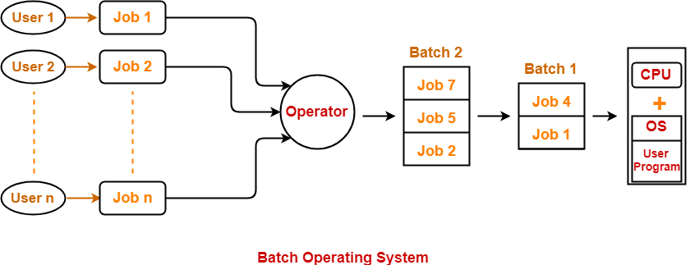
Batch OS

Slide 14
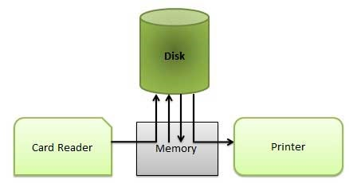
Batch OS: SPOOLing
Memory
CPU
(Simultaneous Peripheral Operation OnLine)

Slide 15
Batch OS: SPOOLing
No interaction of I/O devices with CPU. CPU directly interacts with Disk which is faster.
Input of one job, output of a second job and processing of a third job can be overlapped.
Disadvantage:
Suitable for non-interactive jobs
Execution was based on uniprogramming model

Slide 16
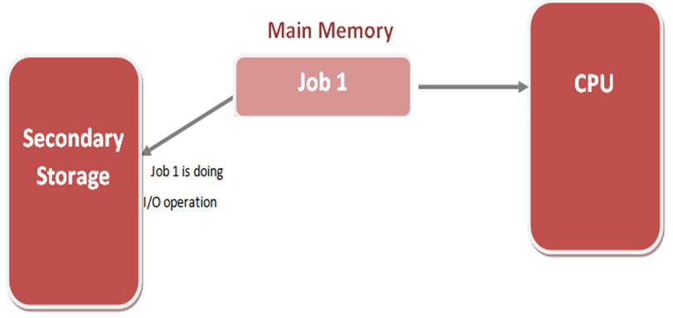
UniProgramming
1
2
3
CPU Idle

Slide 17
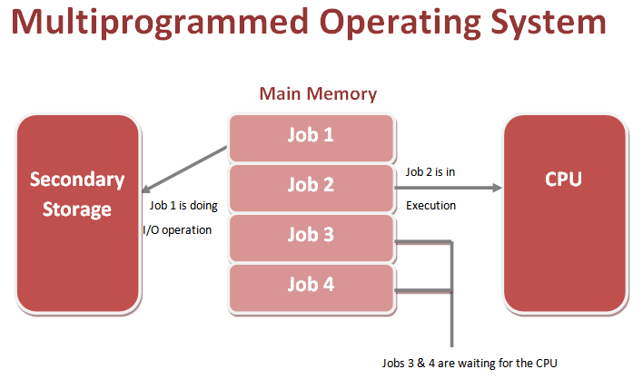
Multiprogramming OS

Slide 18
Multiprogramming OS
jobA = 200ms execution + 30ms i/o at 100th ms
jobB = 100ms execution + NO i/o
CPU idle time = 30ms
A | idle | A | B
0
100 | 130 | 230 | 330
Job | Turn-around time | Response time
A | 230 | 0
B | 330 | 230

Slide 19
Multiprogramming OS
jobA = 200ms execution + 30ms i/o at 100th ms
jobB = 100ms execution + NO i/o
CPU idle time = 0
A | B | A | B
0
100 | 130 | 230 | 300
Job | Turn-around time | Response time
A | 230 | 0
B | 300 | 100

Slide 20
Multiprogramming OS
Advantages
Efficient CPU utilization.
User feels that many programs are allotted CPU almost simultaneously.
Less response time.
Useful when load is more.
Difficulties
Complex CPU scheduling.
Memory management is required to accommodate many jobs

Slide 21
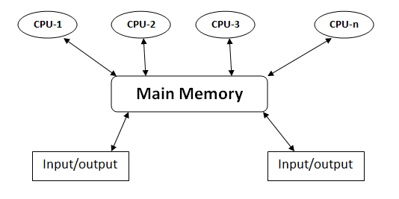
Multiprocessing OS
Multiple processors can execute different processes OR multiple independent instructions of same process

Slide 22
Multiprocessing OS
Advantages
Increased Throughput
Increased Reliability.
True Parallel Processing.
Difficulties
More complex – Scheduling, synchronization.

Slide 23
Time Sharing OS
Predefine time quantum q=20ms (say)
Processes are executed in FCFS order, none exceeding the quantum in a turn
A | B | C | A | B | C | A | …..
0
20 | 40 | 60 | 80 | 100 | 120 | 140

Slide 24
Time Sharing OS
 | Without TS | With TS
Response time | A=0, B=500 | A=0, B=20
Turn-around time | A=500, B=520 | A=520, B=40
job-A: 500ms + NO i/o
job-B: 20ms + NO i/o
Without time sharing
With time sharing
A | B
0
500 | 520
A | B | A | A | A | A | … | A
0
20 | 40 | 60 | 80 | 100 | 120 | 500 | 520

Slide 25
Time Sharing OS
Advantages
quick response.
reduces CPU idle time.
Disadvantages
Switching overhead
More turn-around time
A: 250ms; B: 200ms, q=50ms
 | Resp. time | TA time
A | 0 | 450
B | 50 | 400
A | B | A | B | A | B | A | B | A
50 | 100 | 150 | 200 | 250 | 300 | 350 | 400 | 450

Slide 26
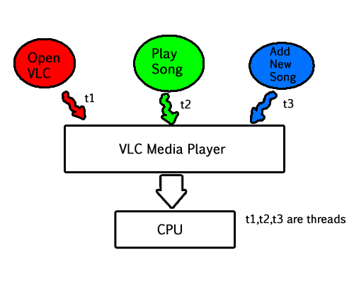
Multi-Threading OS

Slide 27
Multi-Threading OS
Advantages:
Max utilisation of CPU is possible.
Time Saving.
Improves the performances of complex applications.
Parallelizes tasks.
Difficulties:
Complex debugging and testing process.
Increased complexity level in writing a program.

Slide 28
Real Time OS
Real time OSs are specifically designed to execute real time tasks.
Real time tasks are deadline constrained
3 types depending on the consequences of a task missing deadline
Hard real time task
Firm real time task
Soft real time task

Slide 29
Real Time OS
Hard real time tasks
The task and the system is considered to be failed if deadline is not met.
Example
obstacle detection by a robot
anti-missile system

Slide 30
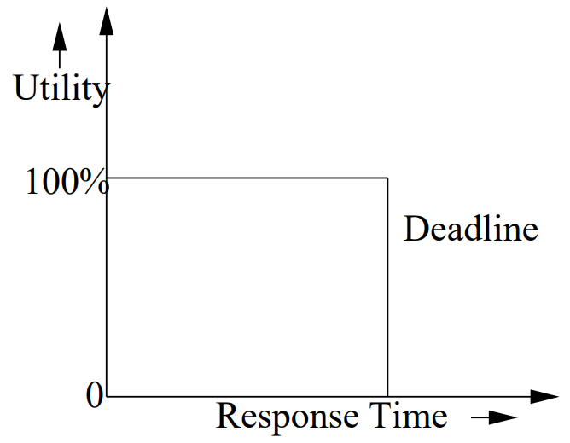
Real Time OS
Firm real time tasks
If a firm RT task fail to meet deadline then the system does not fail.
Late results are simply discarded
Example
Video Conferencing
Satellite based enemy territory tracking

Slide 31
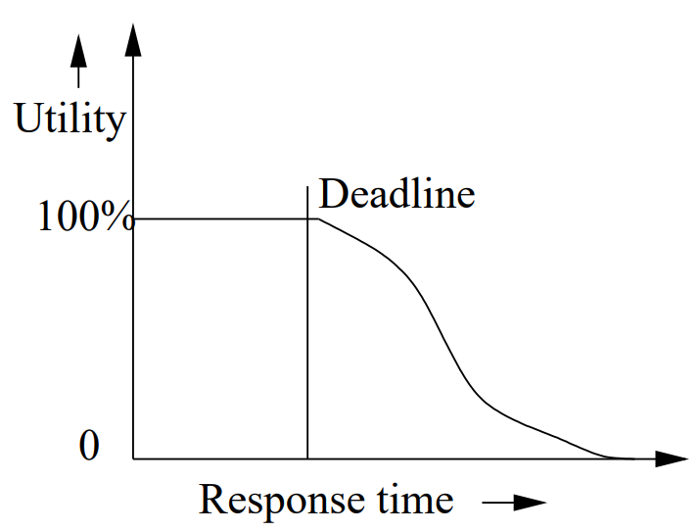
Real Time OS
Soft real time tasks
Deadlines are not absolute, in contrast to Hard and Firm RT tasks
Time constraints are expressed in terms of average response time
Missed deadlines of soft RT tasks does not imply system failure
After the deadline, the utility of the results falls continuously
Example: Web browsing, Railway ticket reservation

